Slide 1
Glade Interface Designer
Glade 2 & 3

Slide 2
GLADE
Glade Interface Designer is a graphical user interface builder tool for GTK+ with additional components for GNOME.
Glade 2 is programming language dependant and produces a code to build the binary Glade 3 is independent of programming languages and produces just a GUI’s XML file
GTK+ : Cross platform widget toolkit for creating GUIs
GNOME : Desktop created with open source software (linux)

Slide 3
WHY GLADE 2 ?
Theme support
Encapsulation
Derivation
Object orientated approach
Internationalization
Inheritance
Less Code
Localization
UTF8 support
Prefixed codes
Documentation

Slide 4
Getting Started with glade
Prerequisites :
Check that you have “glade-3”, “glade-2” or “glade--” installed.
How to check?
Try typing “glade-3”, “glade-3” and “glade--” on your terminal, if not found then, please get installed suitable glade version first (ideally glade-3) on your system.
Note : If you are using 64 bit machine “glade--” cannot be installed.

Slide 5
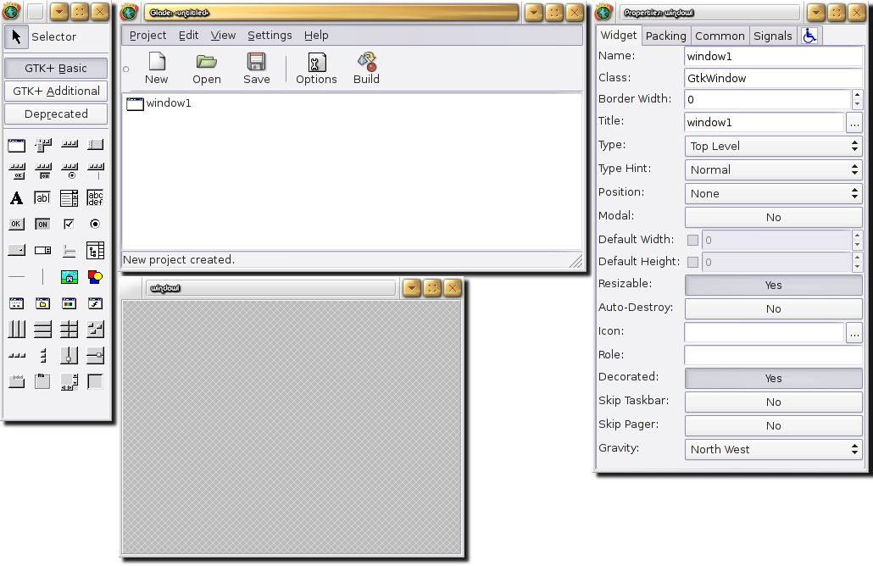
Creating a Project
On the terminal type :
1. glade-2

Slide 6
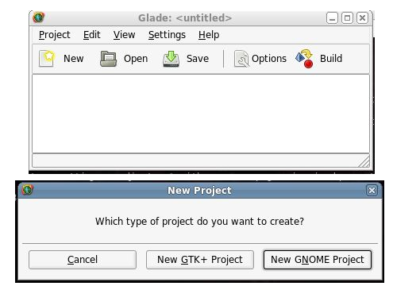
Click on NEW
“New GNOME Project”

Slide 7
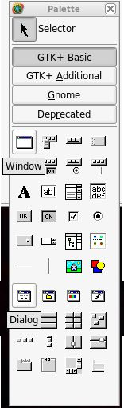
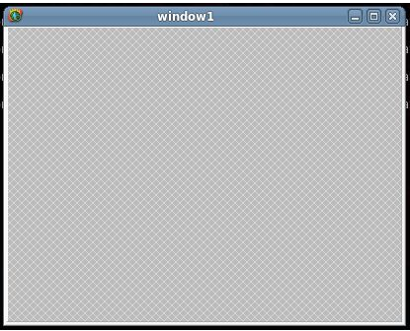
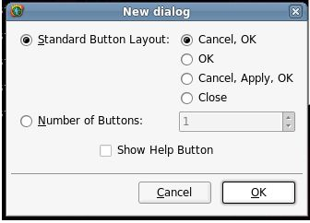
Now you can start by creating to creating either a
WINDOW
or a DIALOG

Slide 8
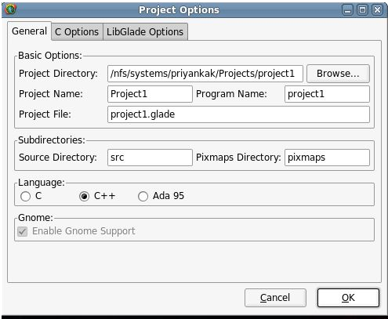
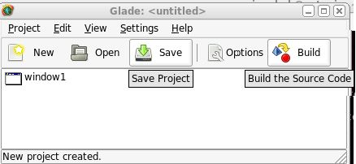
Saving the Project
Clicking on save will create a file with the extension .glade which is your GUI XML code. Later if you need to edit your “glade” file launch by typing “glade-2 test. glade”

Slide 9
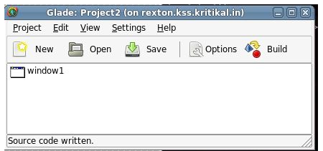
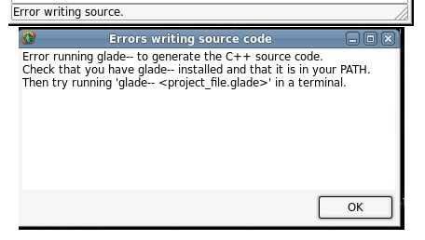
After BUILD you will either get
OR
Your Project is build and ready for compilation!
You Probably have 64 bit machine and
“glade--” is not installed!
In case your “build” doesn’t work, just ssh on a 32 bit machine, open your glade file and then click on “BUILD”

Slide 10
Compiling the GUI
Once you have built your glade files. Now we have to compile our codes and create an executable to finally run the GUI.
Close your glade interface once you are done editing the glade file. Place where you saved your project probably looks like this

Slide 11
Compiling the GUI cont.
Run these commands here
aclocal
autoheader
automake --add-missing
autoconf
libtoolize (optional, this is used to create a library for the executable we will be creating)
./autogen.sh
./configure
Running these commands auto-generate a makefile! (along with some other files) You just have to go to the src/ folder and type make

Slide 12
But wait!
Before you type make you need to run these 2 commands in the terminal too! (Only if you have added signals to your glade files)
sed -i 's/slot/mem_fun/g' *_glade.cc
sed -i 's/SigC::Connection/sigc::connection/g' *_glade.cc
sed -i 's/SigC::Connection/sigc::connection/g' *_glade.cc
make
Side Note : “glade--” package used is actually from an older linux version (suze) and since the syntax has changed from suze to CentOS we need to run these commands.

Slide 13
Adding your code
The command “build” generates 4 files for each window or dialog added in the glade file along + 1 main file (with int main())
eg. If you created a “window” You will have
1.
2.
3.
4.
window1_glade.hh
window1_glade.cc
DO NOT EDIT THESE FILES
window1.hh
window1.cc
Your code goes here!

Slide 14
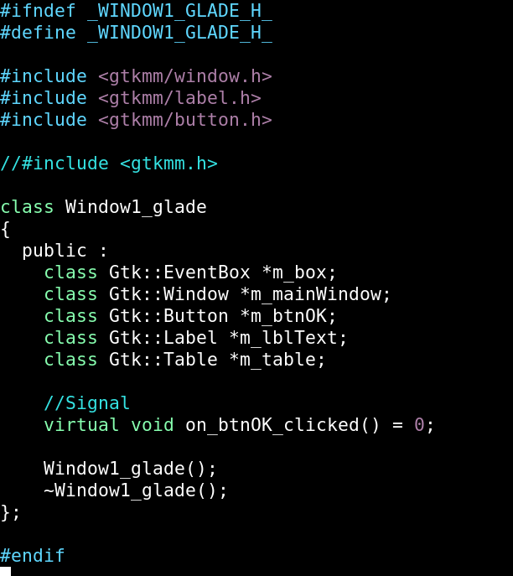
Window1_glade.hh
Here, we have declared several gtk widgets such as Gtk::EventBox, Gtk::Button, Gtk::Label etc (included the respective header files also such as gtkmm/label.h).
Declared a pure virual function named on_btnOK_clicked() as we will give click functionality to the button later on.

Slide 15
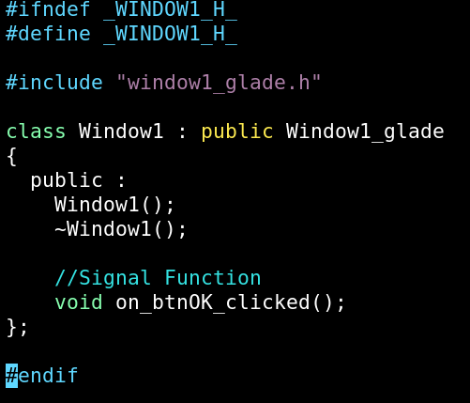
Window1.hh
Here, we have inherited class Window1_glade.h into Window1.h.

Slide 16
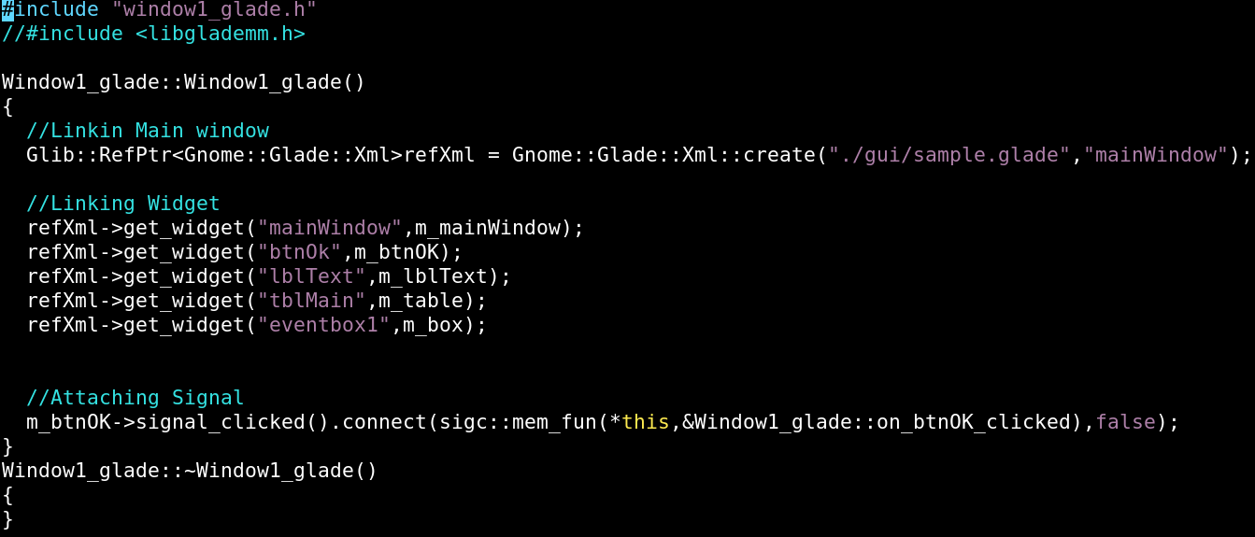
Window1_glade.cc
Here, we are referencing all the declared widgets in Window1_glade.hh to the actual glade file widgets with the same name. Connecting button click signal with the function on_btnOK_clicked().

Slide 17
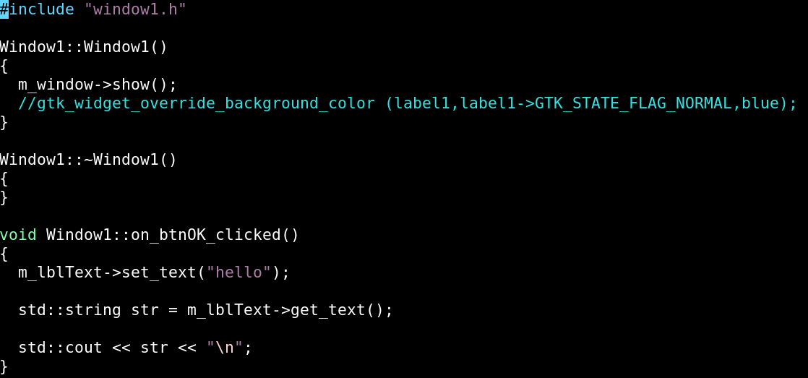
Window1.cc
Here, we are defining the function on_btnOK_clicked() for the button m_btnOk, we declared earlier as the m_lblText will set the text “hello” after clicking the button.

Slide 18
Glade Makefiles
After the first build the glade produces “Makefile.am” and on every other build “Makefile.am_new” is created
If your project needs any new libraries or headers apart from the GUI screen headers then you have to edit the “Makefile.am”
Here Makefile is created from “Makefile.am” (./autogen.sh and ./configure) So If you want to “make” your project with new changes then do “make distclean”, which will delete Makefile along with the object files and the binary, Then recreate the Makefile (./autogen.sh and ./configure) and now when you “make” those changes will be reflected
Note : finally the make is done using the Makefile only!

Slide 19
Assignment
Write a application for a form of employee registration which has following fields:
Name (Gtk::Entry)
Department (Gtk::Combo)
Photo upload option using browse(Gtk::DrawingArea, Gtk::FileSelectionDialog)
Employee listing (Gtk::TreeView)
Male/Female selection (Radio Button)
All the widgets should be put into Gtk::Vbox/Gtk::HBox. For proper alignment.

